Slide 1
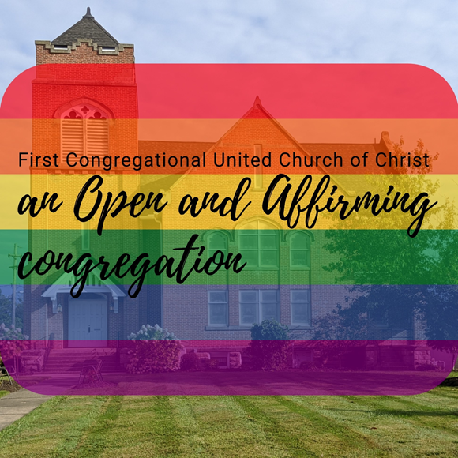
First Congregational UCC
2022 Narrative Budget

Slide 2
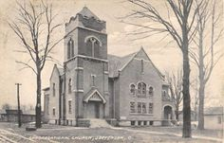
What is Mission?
Mission is the act of intentional service in a Congregation to uphold the vision, ethics and values of Jesus the Christ and the mutual ministry of it worship participants, the wider church and the Kin-dom of God.

Slide 3
A Church Budget’s #1 Goal Should Support the Life and Ministry of the Congregation
A Church Budget should embrace the vision of the Church.
Led by the Holy Spirit, we affirm God's love by growing spiritually, pursuing justice and caring compassionately for all.
Should Cultivate Spirit Led Leadership
Foster Christ Centered Connection
Be Rooted in God Centered Action

Slide 4
A Budget: is A road Map pointing the Direction an Organization wants to Go. 2021 Total: $84,513 2021 Budget: $134,910 2021Expenses $93,156.20 2021 Income: $78,796.45 General Fund $72,006.00 ($6,000) From Association 2021 Total $78,006.00

Slide 6
Offering 25% of our General Funds are received through Pledges. Recurring Online Contributions Weekly Offerings

Slide 7
Assets

Slide 8
Possible New Streams

Slide 10
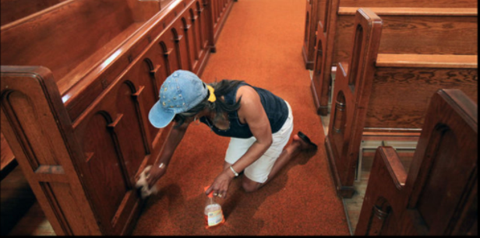
Church Building and Grounds
2022 Budget : $19,650
2021 Budget: $21,400

Slide 11
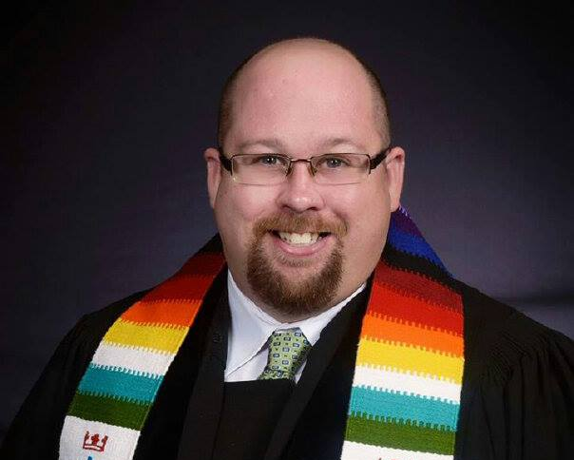
Pastor’s Package

Slide 12
Pastor’s Package
2021 Budget: $81,000*
2020 Budget: $82,690
.

Slide 13
Pastor’s Package 2022
Will revisit in June Congregational Meeting

Slide 14
2021 Proposed Giving Strategy: 5 for 5
OCWM: $1,500
Strengthen The Church: .5% of our Budget = $660
One Great Hour of Sharing: .5% of our Budget: $660
Neighbors in Need: .5% of our Budget: $660
Christmas Fund: .5% of our Budget: $ 660

Slide 15
5 for 5 Offerings will Revert to 2020 Method

Slide 16
Our Church’S Wider Mission

Slide 17
Worship as Mission

Slide 18
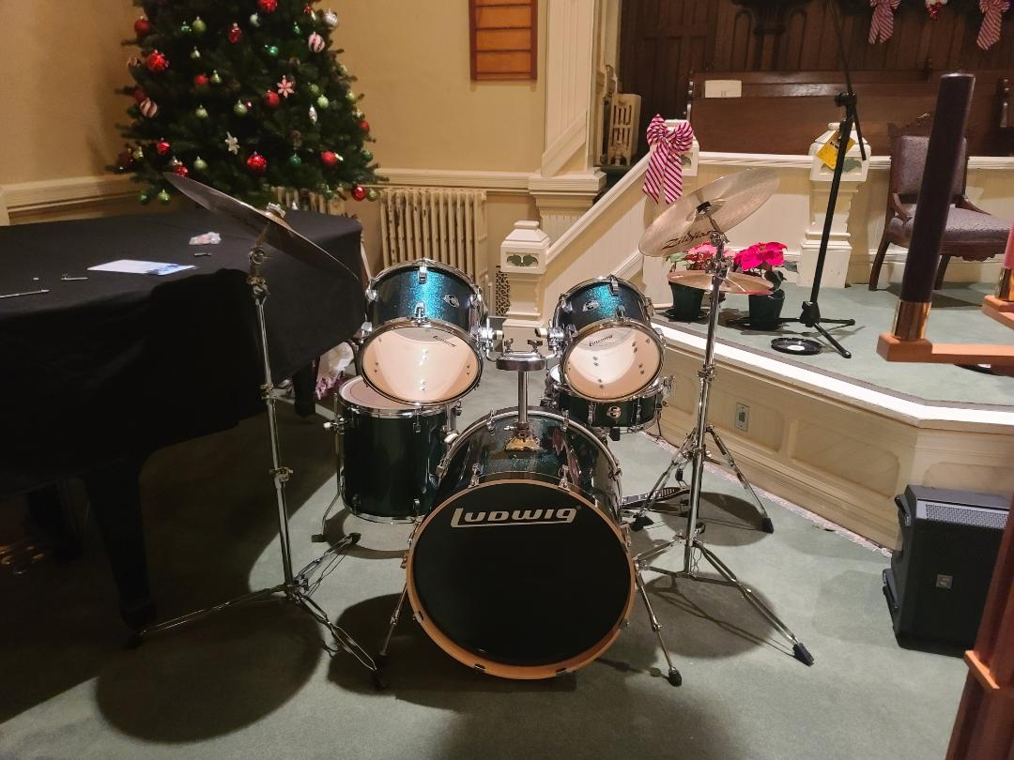
Worship
In Christianity, worship is the act of attributing reverent honor and homage to God.
At First Congregational UCC Music is a key component of our Worship Experience.
Our Organist, Gary Yost, has been working to organize a “Jazz Choir.” Memorial provided the drumset.
The care for the Communion Table and the Paraments are a role of Diaconate as well as coordinating with the pastor for pulpit Supply.
These Special Functions in the church are part and parcel to the budget.

Slide 19
Committees that are Centered In Faith Formation
Each of our Committees are important to the life and ministry of our church.
Faith Formation
Diaconate
Missions and Memorial
Stewardship
Each Committee will have opportunity to request funds on as needed basis. Thinking creatively to accomplish ministry will be key in 2022!

Slide 20
Workshops, Evaluation and Implementation

Slide 21
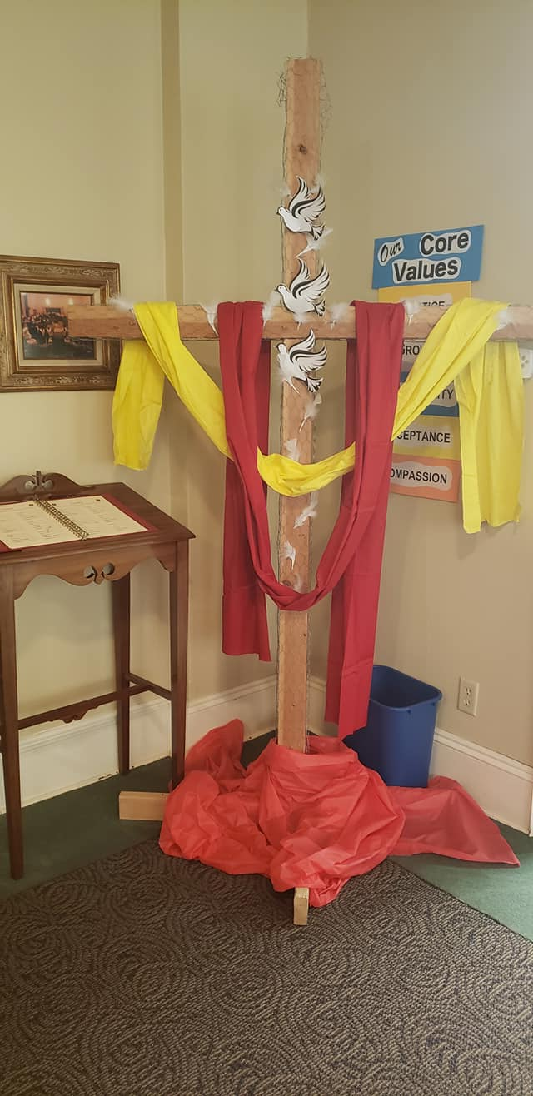
Diaconate
Through your generous donations Diaconate Provides:
Communion Elements
Maintains Paraments ( Banners and Communion Cloths.)
Dresses the Church for Church Holidays. Ex Christmas, Easter, Pentecost, PAAM Sunday etc.
Coordinates with Pastor the Pulpit Supply in Pastor’s Absence.

Slide 22
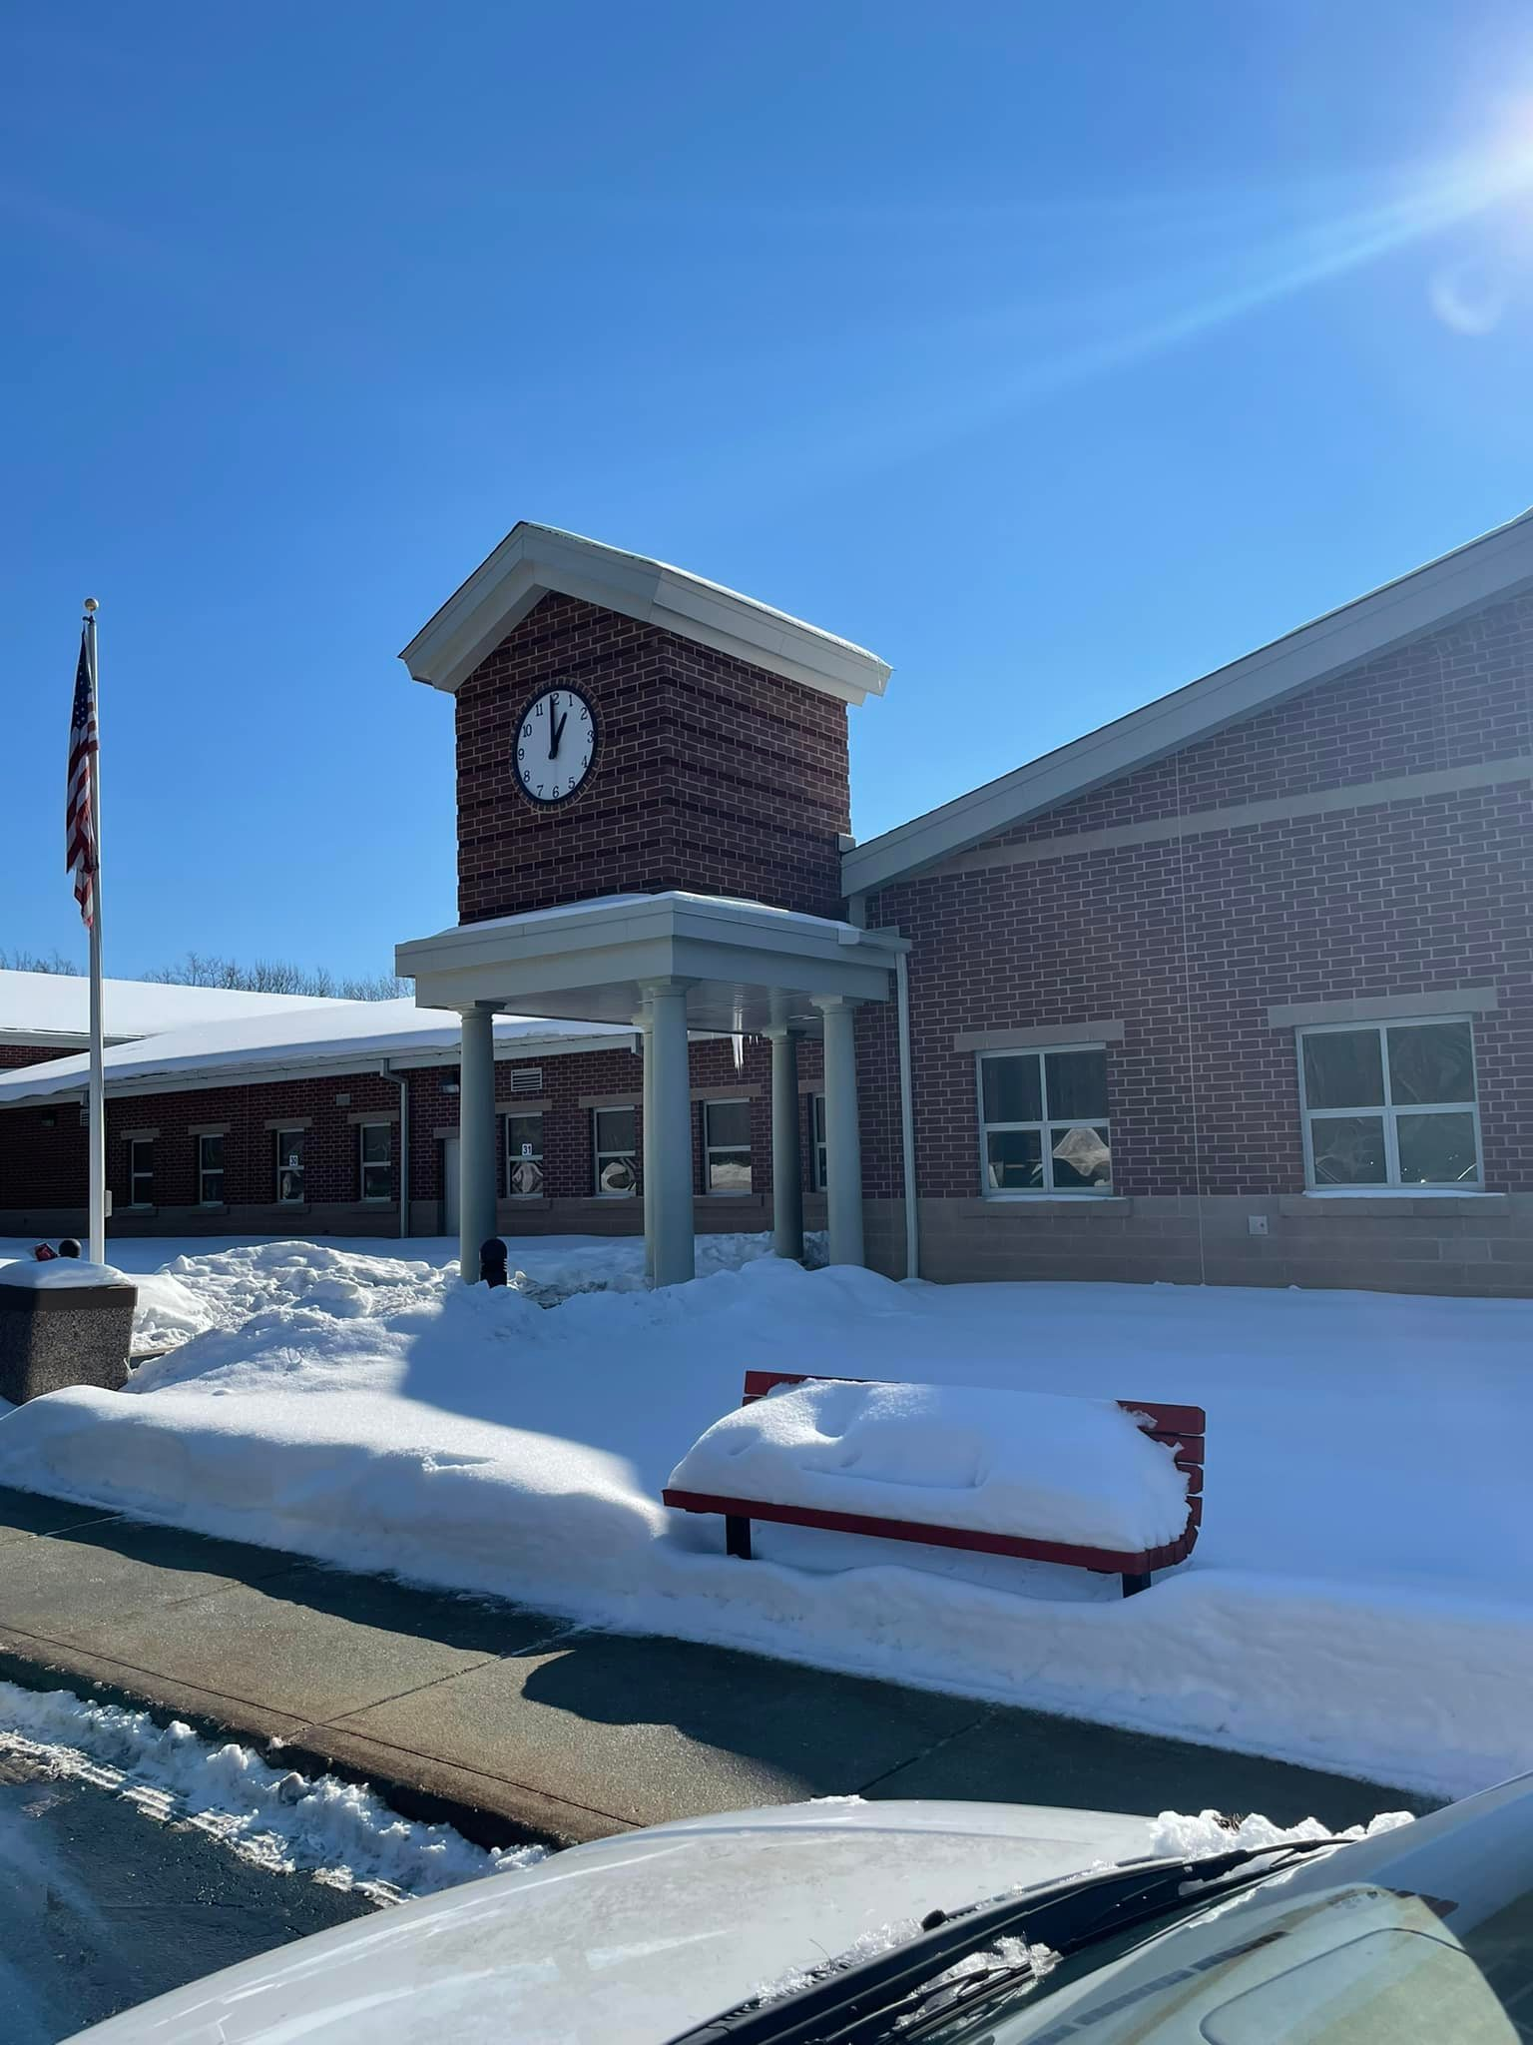
Missions Supports…Well Mission SweatPants for Scholars: Jefferson and Rock Creek Elementary Schools
63 pairs of Hanes sweatpants were donated: $538.02

Slide 23
Mitten Tree
This year’s collection of Hat’s mittens and scarves that were adult sized were given to the Psychiatric Department at ACMC.

Slide 24
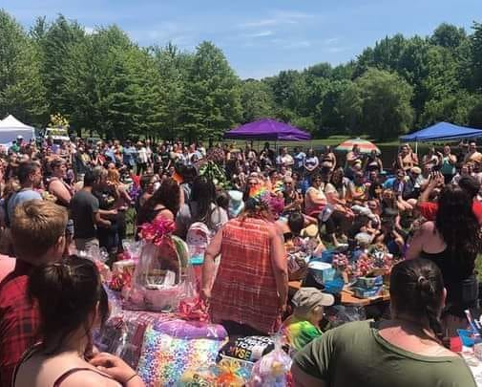
Pride
We Sponsored Ashtabula County’s First Pride at Hamper’s Farm.
Platinum Sponsorship $1,015

Slide 25
Outdoor Worship and Purchase of New Speakers!

Slide 26
Pride Sunday

Slide 27
Reception of New Members

Slide 28
Christmas Cooke Fundraiser $200+

Slide 29
A Budget: is A road Map pointing the Direction an Organization wants to Go. 2021 Total: $84,513 2021 Budget: $134,910 2021Expenses $93,156.20 2021 Income: $78,796.45 General Fund $72,006.00 ($6,000) From Association 2021 Total $78,006.00

Slide 30
First Congregational Wants you to know!

